Slide 1
Audio Emotion Classifier
Xiangzhi Chen (Theon)

Slide 2
01
Intro

Slide 3
Why Emotion in Speech Matters
Humans communicate emotion through voice
Current AI understands what we say, not how we feel
The ability to automatically recognize emotions has become increasingly important:
human-computer interaction (AI companionship)
virtual assistants
mental health assessment

Slide 4
Challenge of Emotion Recognition
Speech varies by:
Speaker
Language
Recording conditions
Models trained on one dataset may not perform well in real-world data
👉 Generalization is the main problem.

Slide 5
Research Objective
The goal: to test whether a single model can learn general emotional patterns across diverse data
Approach:
Combine multiple datasets
Employ a hybrid deep learning model

Slide 6
02
Dataset

Slide 7
Multi-Dataset
6 emotions:
Angry, Disgust, Fear, Happy, Neutral, Sad
10,000+ audio samples from 9 datasets
Public datasets: RAVDESS, CREMA-D, EmoDB, ShEMO…
Self-collected: Friends, iPartment(Chinese TV series)
By combining datasets, I am trying to simulate more realistic conditions and test how well the model generalizes

Slide 8
03
Preprocessing

Slide 9
Preprocessing Pipeline
From Audio → Model Input
Steps:
Resample to 22,050 Hz
Trim silence Convert to Mel-spectrogram
Fixed length (8 sec)
Data Augmentation
Time masking + Frequency masking (randomly hide parts of the spectrogram )

Slide 10
04
Model

Slide 11
Model Architecture
Mel-Spectrogram
↓
ConvNeXt CNN Backbone
↓
Transformer Encoder
↓
Attention Pooling
↓
Emotion Prediction
Hybrid CNN–Transformer Model
Pipeline:
CNN → extracts local features
Transformer → capture time relationships
Attention → focus on important parts

Slide 12
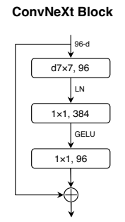
For ConvNeXt…
Outside ConvNeXt blocks:
A stem convolution layer that increases the channel dimension to 32
Inside:
A depthwise convolution (kernel 7×7) to process channels independently
A normalization layer to stabilize feature distributions
A pointwise convolution-based MLP that expands and then compresses channel dimensions
A residual connection to facilitate gradient flow

Slide 13
For Transformer + Attention…
Transformer:
Transformer encoder composed of two layers with multi-head self-attention
Capture long-range dependencies and contextual relationships
Attention-based pooling:
Learns weights over time steps, allowing the model to focus on the most emotionally informative parts of the speech signal

Slide 14
05
Result

Slide 15
Performance Summary
Test Accuracy: 71%
Emotion | Precision | Recall | F1-score | Support
Angry | 0.75 | 0.89 | 0.81 | 298
Disgust | 0.62 | 0.79 | 0.69 | 229
Fear | 0.63 | 0.73 | 0.67 | 238
Happy | 0.78 | 0.44 | 0.56 | 233
Neutral | 0.75 | 0.83 | 0.79 | 292
Sad | 0.82 | 0.50 | 0.63 | 242

Slide 16
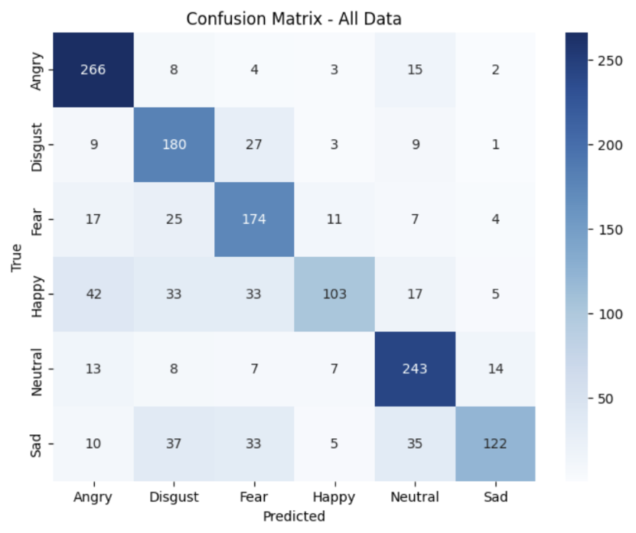
Emotion-Level Results
Strongest performance on angry and neutral
Disgust and fear share overlapping acoustic features, which can cause confusion
Lower performance is observed for sad and particularly happy
Model struggles with subtle or low-intensity emotions, where acoustic differences are less pronounced

Slide 17
Dataset-Level Results
The model performs very well on clean, structured datasets like TESS and RAVDESS Song. But performance drops significantly on real-world datasets like Friends (33.3%)
EMOVO (50.0%) presented moderate difficulty, which could be caused by differences in language (Italian) and less consistent intensity
The model performs best on clean and well-structured datasets. In contrast, performance degrades on datasets with greater variability, naturalistic speech, and less distinct emotional boundaries

Slide 18
Overall
Emotion recognition performance is not only emotion-dependent but also highly dataset-dependent
Emotions with clear and strong acoustic signatures are more reliably classified, while those with subtle or overlapping characteristics remain challenging—especially in datasets with greater linguistic diversity or naturalistic recording conditions

Slide 19
05
Conclusion

Slide 20
In Conclusion
👉It is possible to extract useful emotional representations from heterogeneous audio data
👉Emotions with clear acoustic patterns, such as anger and neutral, are more reliably recognized, while more subtle emotions like happiness and sadness remain difficult due to overlapping features
👉Dataset characteristics—such as recording quality, speaker diversity, and expression style—do have a significant impact on performance

Slide 21
Limitations + Future Work
Limitations:
The datasets vary in quality and labeling standards, which makes learning harder
The model requires substantial training time on a standard laptop GPU, making extensive hyperparameter tuning difficult
Future:
Improving data quality and consistency
Integrating additional modalities, such as text or facial expressions

Slide 22
References
Liu, Zhuang, Hanzi Mao, Chao-Yuan Wu, Christoph Feichtenhofer, Trevor Darrell, and Saining Xie. "A convnet for the 2020s." In Proceedings of the IEEE/CVF conference on computer vision and pattern recognition, pp. 11976-11986. 2022.

Slide 23
Thank You!

